Slide 1
User Profiles
Chapter 02
Usability Engineering Life Cycle by
Deborah J. Mayhew

Slide 2
How today’s lecture works
HOW TODAY WORKS
look for these badges in the top-left of a slide
POLL
Vote with your hands — everyone answers, no one is wrong.
QUIZ
Answer on paper first; the next slide reveals the answer.
THINK-PAIR-SHARE
1 min alone → 2 min with your neighbour → a few pairs share.
LIVE EXERCISE
Do it now, in class, on paper.
CASE PUZZLE
A real situation; apply today’s idea to it in pairs.
Today: Part A user profiles (Mayhew Ch. 2) → 10-min break → Part B task analysis (Dix Ch. 15); 11 activities, ~45 min
Have ready: a sheet of paper and a pen
Notes:
2-hour session, one deck. 0:00 warm-up · 0:05 Part A user profiles · 0:55 break · 1:05 Part B task analysis · 1:55 exit ticket.
Spend 30 seconds here: every activity slide carries one of these badges. In a POLL everyone votes, even if unsure.
If time runs short, drop first: Fix this questionnaire (answers can be shown directly), then the XOR/AND/OR quiz.

Slide 3
Warm-up: same app, two users
THINK-PAIR-SHARE
4 min · 1 alone, 2 in pairs, 1 share
Nani, 70
First smartphone. Reads Urdu comfortably, English slowly. Has always paid bills at the bank counter.
Hamza, 19
CS student. Pays everything on his phone. Hates waiting and extra taps.
You are designing ONE bill-payment app for both of them.
Write: three things that must be different for Nani and Hamza, and one thing that must NOT be different.
What you just did has a name: user profiling. That is today’s topic.
Notes:
THINK-PAIR-SHARE, 4 minutes. 1 minute alone, 2 minutes in pairs, 1 minute taking answers.
Expected: text size and contrast; Urdu option; fewer steps and a guided flow for Nani; saved billers, shortcuts and speed for Hamza; clear confirmation and a receipt (trust).
Must NOT differ: the core task (pay the right bill, the right amount), security, accuracy.
Bridge: “Who are the users, what is their goal, what tasks are involved?” — next slide.

Slide 4
What is user profile?
The process of establishing knowledge about the users
Find out who users are
Children, Elders, Professional, Scientist, Male, Female, Tech Experts, IT Illiterate
What is the goal in using the product?
Withdraw cash, pay bills, find out movie time, online chat, gaming, research etc.
What are the tasks involved?
(Observe existing work practices)
E.g. To apply for leave
Check schedule, Get Leave application form from admin, fill in the form, get it approved from Manager, inform colleagues and go on leave

Slide 5
Why user profiling
System will fail if it
Does not do what the user needs
Is inappropriate to the users
The System must match the user’s tasks and must meet the requirements
Why do user profiling, why not define “good” interfaces and just based your design on them?
infinite variety of tasks and users guidelines can be too vague to be generative

Slide 6
WHO ARE THE USERS
Identify attributes of users
Physical characteristics:
height; physical abilities or disabilities
Background:
education; social; religious
Skills:
task experience
Preferences:
efficiency

Slide 7
WHERE IS THE TASK PERFORMED
Office, laboratory, POS? (while standing, while sitting, in a crowded place, effects of environment)
Are users under stress? (in an operation theatre)
Is confidentiality required? (information displayed)
Do Users consume drinks while doing tasks?
What kind of lighting do they work under?
Surrounding noise

Slide 8
RELATIONSHIP BETWEEN USER AND DATA
Personal data
always accessed at same machine?
Common data
used concurrently?
Passed sequentially between users?
Access to data restricted?

Slide 9
HOW OFTEN ARE TASKS PERFORMED
Frequent users remember more details
Infrequent users may need more help even for simple operations
Which function is performed
most frequently?
by which users?
optimize system for these tasks will improve perception of good performance

Slide 10
WHAT ARE THE TIME CONSTRAINTS
What functions will users be in a hurry for?
Positioning of functions
Which can wait?
Is there a timing relationship between tasks?
Time out

Slide 11
Which profile question was skipped?
QUIZ
4 min · alone, then compare with your neighbour
1
A hospital system logs nurses out after 2 idle minutes — mid-entry.
2
A bank kiosk in a sunlit mall is unreadable at noon.
3
A shared lab PC shows the previous student’s marks.
4
The monthly fee challan sits three menus deep.
5
A pharmacy app uses English-only medical terms for elderly rural users.
6
A factory touchscreen needs precise taps from workers wearing gloves.
Who? · Where? · User and data · How often? · Time constraints
Notes:
QUIZ, 4 minutes (2 alone, 2 compare). For each failure, name the profile question nobody asked.
The five questions are on the footer: who, where, user and data, how often, time constraints.

Slide 12
Which profile question was skipped? — answers
ANSWERS
the question nobody asked
1
A hospital system logs nurses out after 2 idle minutes — mid-entry.
2
A bank kiosk in a sunlit mall is unreadable at noon.
Time constraints: time-out
Where: lighting
3
A shared lab PC shows the previous student’s marks.
4
The monthly fee challan sits three menus deep.
User and data: personal data on a shared machine
How often: optimise the frequent task
5
A pharmacy app uses English-only medical terms for elderly rural users.
6
A factory touchscreen needs precise taps from workers wearing gloves.
Who: background and skills
Who: physical; where: environment
Each failure was cheap to prevent at the profile stage and expensive to fix later.
Notes:
ANSWERS. Accept two-category answers: 3 is data AND confidentiality; 6 is physical AND environment.
Ask: which of these would a usability test with CS students have caught? (Almost none — that is why we profile the real users.)

Slide 13
USER REQUIREMENT
Captures the characteristics of the intended user group
Novice & Casual (clear step by step intro)
Expert & Frequent (flexible interactions, wide range of power/control, short cut keys)
Analyse the results of user profiling and identify the impact to your interface design
Know your users – always!

Slide 14
Novice or expert feature?
POLL
3 min · 1 finger = novice · 2 fingers = expert
1
A step-by-step wizard for your first fee payment
2
Ctrl+Enter to submit a grade
3
A tooltip that explains “CGPA”
4
Approve 20 leave requests in one batch
5
A plain-language check before you submit
6
A dashboard you can rearrange
Remember the user requirement slide: novice & casual vs expert & frequent.
Notes:
POLL, 3 minutes. Read each item; hands up with 1 or 2 fingers.

Slide 15
Novice or expert feature? — answers
ANSWERS
novice & casual vs expert & frequent
1
A step-by-step wizard for your first fee payment
2
Ctrl+Enter to submit a grade
NOVICE
EXPERT
3
A tooltip that explains “CGPA”
4
Approve 20 leave requests in one batch
NOVICE
EXPERT
5
A plain-language check before you submit
6
A dashboard you can rearrange
NOVICE
EXPERT
Good systems give both: a guided path novices can follow and shortcuts experts discover.
Notes:
ANSWERS. Point out that the two columns live in one interface: accelerators that novices can ignore and experts find.

Slide 16
DATA GATHERING
What:
How do we go about determining requirements and concluding the results
An important part of the requirement activity
and also evaluation activity
Why:
Purpose is to collect sufficient, relevant and appropriate data to produce a set of reliable requirements/conclusions.

Slide 17
DATA GATHERING TECHNIQUES
Questionnaires
A series of questions designed to elicit specific information
Can give quantitative and qualitative data
Administered at distance, no one to explain & help in answering
Advantages, disadvantages
Interviews
Involves asking someone a set of questions (often f2f)
Good for exploring issues, encourage people to respond Advantages, disadvantages

Slide 18
Continue…
Workshops or focus groups
Group interviews rather than one on one
Gain a consensus view and/or highlighting areas of conflicts
Facilitator is required to keep conversation on track
Has to be carefully structured, participants have to be carefully chosen
Advantages, disadvantages

Slide 19
Continue…
Naturalistic observation
Spend time with stakeholders in their day to day tasks, observing work as it happens
Good for understanding the nature and context of the tasks
Take notes, ask question (not too many)
Variation of this - ‘Ethnography’
Observing from the ‘inside’ as a participant, full involvement
Advantages, disadvantages

Slide 20
Continue…
Studying documentation
Good for getting background information on procedures and rules (manuals, job logs)

Slide 21
Fill in the red line: advantages, disadvantages
THINK-PAIR-SHARE
5 min · pairs · one + and one − for each technique
Technique
+ Advantage
− Disadvantage
Questionnaires
Interviews
Workshops / focus groups
Naturalistic observation
Ethnography
Studying documentation
Notes:
THINK-PAIR-SHARE, 5 minutes. The red “Advantages, disadvantages” lines on the last four slides are for the class to fill in.
Pairs write one advantage and one disadvantage per technique; take one row from each of six pairs.

Slide 22
Advantages, disadvantages — answers
ANSWERS
one + and one − for each technique
Technique
+ Advantage
− Disadvantage
Questionnaires
Reach many people cheaply; numbers are easy to analyse
Nobody to explain a question; low return rate
Interviews
Explore issues in depth; can follow up
Slow; few people; interviewer can bias answers
Workshops / focus groups
Show consensus and conflict quickly
Need a skilled facilitator; loud voices dominate
Naturalistic observation
See real work in its real context
Time-consuming; people act differently when watched
Ethnography
Insider view as a full participant
Slowest of all; hard to generalise
Studying documentation
Cheap background on rules and procedures
Shows what should happen, not what does
Notes:
ANSWERS. Accept any reasonable + and −. The key contrasts: questionnaires = breadth, interviews = depth; observation shows what people DO, documentation what they are SUPPOSED to do.
Link: in Lab 5 you use interviews + a short questionnaire for your team project.

Slide 23
PROBLEMS WITH DATA GATHERING
Identifying and involving stakeholders
Availability of key people
Communication between parties
Within development team (more technical)
With customer/user (less technical)
Between users (different parts of an organisation use different terminology
e.g. End of Module Report for APIIT vs Module Report for SU)

Slide 24
QUESTIONNAIRE DESIGN
Keep questions short
Only ask a question if it contributes to design
Use closed questions for ease of analysis
Always pilot questionnaires/interview schedules

Slide 25
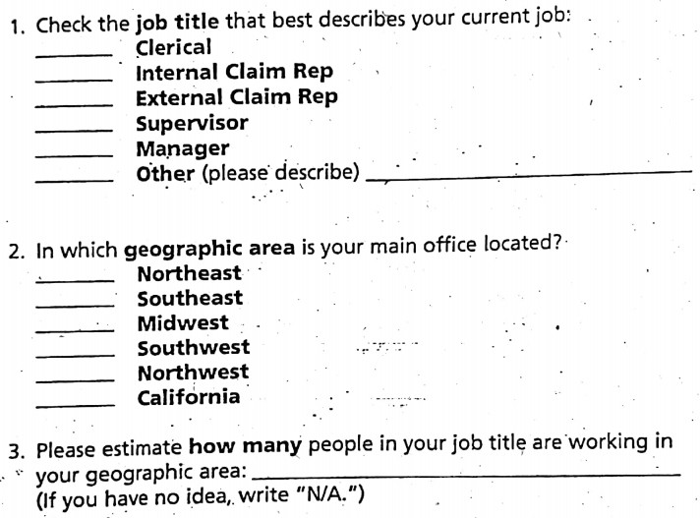

Slide 26
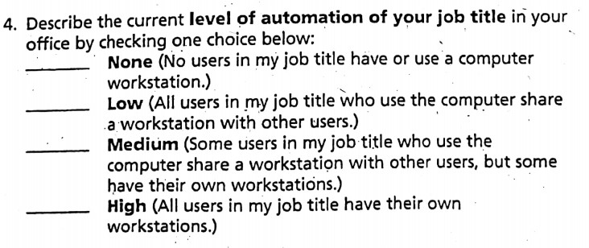
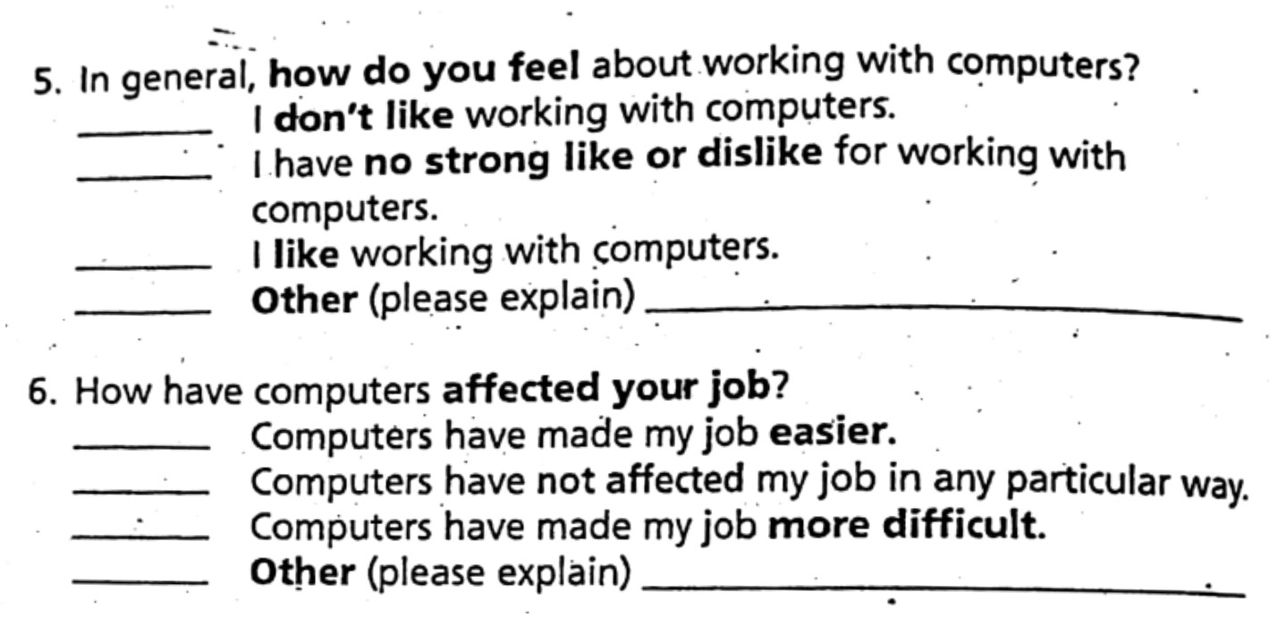

Slide 27
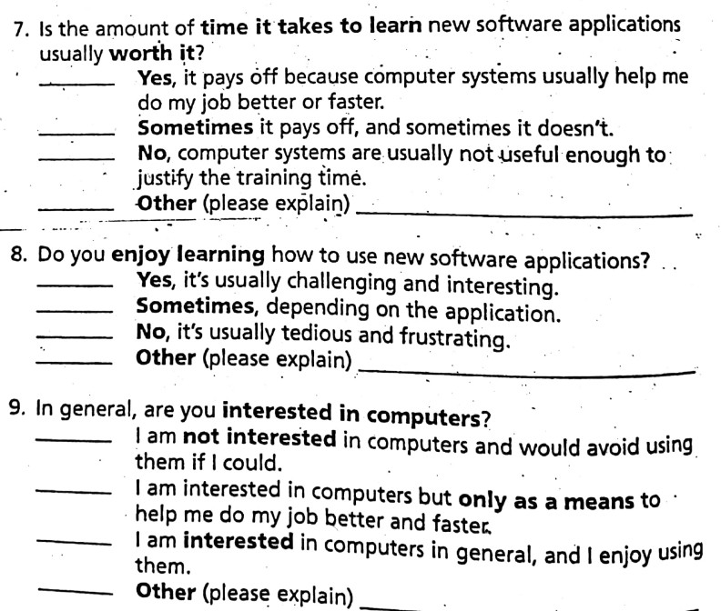

Slide 28
Fix this questionnaire
LIVE EXERCISE
6 min · pairs · find the flaw, rewrite the question
1
How often and how easily do you use the hostel portal?
2
Age: ☐ 18–20 ☐ 20–22 ☐ 22+
3
Don’t you agree the new portal is much better?
4
What is your favourite colour?
5
Describe your experience with the system.
Rules from the slide: keep it short · only ask if it contributes to design · use closed questions · always pilot.
Notes:
LIVE EXERCISE, 6 minutes in pairs: a draft hostel-portal survey with one flaw per item. Write the flaw and a rewrite.
Drop-first activity if Part A runs long: show the answer slide directly.

Slide 29
Fix this questionnaire — answers
ANSWERS
flaw → fix
1
How often and how easily do you use the hostel portal?
Two questions in one
Split: frequency and ease, each on a closed scale
2
Age: ☐ 18–20 ☐ 20–22 ☐ 22+
Options overlap; under-18 missing
Under 18 · 18–19 · 20–21 · 22 or over
3
Don’t you agree the new portal is much better?
Leading question
“Compared with the old portal, the new one is: much worse … much better”
4
What is your favourite colour?
Does not contribute to design
Delete it
5
Describe your experience with the system.
Open question — hard to analyse
A closed rating, plus one optional comment box
Rules from the slide: keep it short · only ask if it contributes to design · use closed questions · always pilot.
Notes:
ANSWERS. Item 2 (overlapping options) is exactly what Mayhew’s pilot step checks: “mutual exclusivity of MCQs”.
Item 4 fails “only ask a question if it contributes to design”.

Slide 30
Sample Technique: A step by Step procedure to get user profile
There are two main ways to get user profile
Questionnaires distributed to actual users
Interview with the people knowledgeable about the whole population of users
1. Determine user Categories
Determine who the intended users for a product are
Often they fall into already defined categories i.e Doctors, nurse, technicians, IT Experts etc.
What kind of development organization you work in
Internal Dev. Organization have a definition of users, usually by job category.
For Vendor company, identifying users is a bit trickier.

Slide 31
Continue…
2. Determine Relevant user Characteristics
Start wit the Questionnaire and hold meeting with appropriate project team members, UI designers and Usability Engineer
Gather input on user characteristics that should be polled in user profile
3. Develop Draft Questionnaire
Revise and Expand questionnaire to tailor it to specific organization or project needs
Write an introduction explaining the purpose and benefits of questionnaire

Slide 32
4. Get Management feedback on the draft
You will need management’s input and approval on your draft questionnaire
5. Revise the Questionnaire
To incorporate management feedback

Slide 33
6. Conduct a pilot questionnaire with interviews
Conduct a mockup interviews with other members of organization or respondent users
Go through each question and check for clarity of wording, completeness, mutual exclusivity of MCQs.

Slide 34
7. Revise the Questionnaire
Revise to incorporate interview feedback
8. Select a user sample
Response rate to mailed questionnaires is about 10%
This percentage increase if questionnaire is attached with proper cover letter signed by higher authority in an organization
Decide to send to equal numbers of each known, significant user category.

Slide 35
9. Distribute the Questionnaires
Use interoffice mail, regular mail or email to distribute questionnaires
Give clear return deadline
10. Design data entry/analysis
Plan to collate and summarize any free-form comments
And plan to use spreadsheet, statistics packages or simple pen and paper to aggregate information

Slide 36
11. Enter Data
As questionnaires are received, enter data as planned
12. Summarize Data
When all questionnaires are returned by deadline, analyze data as planned
13. Interpret Data
Write a short (several pages) summary providing a synopsis of the key characteristics of each user category and draw specific implications for user interface design
Do not make assumptions

Slide 37
14. Present Results
Distribute the narrative conclusion and design implications, with data summary form as an appendix, to all interested parties.

Slide 38
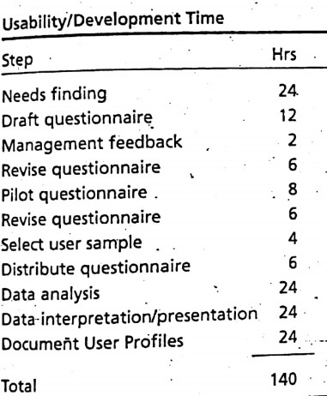
Level Of Effort

Slide 39
Quick calc: how many questionnaires?
QUIZ
2 min · alone, on paper
Scenario: you need about 30 usable replies from each of 3 user categories (students, teachers, admin staff).
Step 8 says
Mailed questionnaires: about 10% come back.
Send equal numbers to each significant user category.
How many questionnaires do you send in total?
Write the calculation, not just the number.
Notes:
QUIZ, 2 minutes.
Ask: how could you get the same 90 replies with fewer questionnaires? (Senior cover letter, clear deadline, interviews with people who know the user population — the second route on the Sample Technique slide.)

Slide 40
Quick calc: how many questionnaires? — answer
ANSWERS
step 8 in numbers
Scenario: you need about 30 usable replies from each of 3 user categories (students, teachers, admin staff).
Step 8 says
Mailed questionnaires: about 10% come back.
Send equal numbers to each significant user category.
30 ÷ 0.10 = 300 per category
× 3 categories = 900 questionnaires
And the effort? Mayhew’s level-of-effort table totals 140 hours ≈ 3½ working weeks for one analyst. A cover letter signed by someone senior raises the return rate.
Notes:
ANSWER: 30 / 0.10 = 300 per category; 3 categories → 900 questionnaires.
Ask: how could you get the same 90 replies with fewer questionnaires? (Senior cover letter, clear deadline, interviews with people who know the user population — the second route on the Sample Technique slide.)

Slide 41
Reference
The Usability Engineering Lifecycle by Deborah J.Mayhew, Chapter 02

Slide 42
10-minute break
HOW TODAY WORKS
back in 10 minutes
Part A done: who the users are, where they work, how often and how urgently — and how to gather that data.
Part B next: task analysis — what users do, what they act on, and what they need to know.
Notes:
Break, 10 minutes. Restart on time with the Task Analyses title slide.

Slide 43



Task Analyses

Slide 44
How you will define Usability?
•How easy to learn the user interface is for novice and casual users
How easy to use (Efficient, flexible, Powerful) the user interface is for frequent and proficient users, after they have mastered the initial learning of the interface.
•Usability is achieved through a process called Usability Engineering

Slide 45
Benefits of more usable or user friendly products
Increased productivity
Decreased user training time and cost
Decreased user errors
Increased accuracy of data input and data interpretation
Decreased need for ongoing technical support
Greater profits due to more competitive products/services
Decreased overall development and maintenances costs
More Follow-on business due to satisfied customers

Slide 46
Usability Engineering Lifecycle
Phase 1
User Profile
Contextual Task Analyses
Usability Goal Setting
Platform capabilities and Constraints
General Design Guidelines
Phase 2
Design, Testing and Development

Slide 47
What is Task Analysis?
The process of analyzing the way people perform their jobs
The things they do
The things they act on
The things they need to know

Slide 48
An Example
in order to clean the house
    get the vacuum cleaner out
    fix the appropriate attachments
    clean the rooms
    when the dust bag gets full, empty it
    put the vacuum cleaner and tools away
must know about:
    vacuum cleaners, their attachments, dust bags,
    cupboards, rooms etc.

Slide 49
Approaches to task analysis
Task decomposition
splitting task into (ordered) subtasks
Knowledge based techniques
what the user knows about the objects and actions involved in a task and how that knowledge organised
Entity/object based analysis
Object-based approach where emphasis on the actors and objects
relationships between them and the people who perform them

Slide 50
Task Decomposition
Aims:
describe the actions people do
structure them within task subtask hierarchy
describe order of subtasks
Variants:
Hierarchical Task Analysis (HTA)
most common

Slide 51
Textual HTA description
Hierarchy description ...
0. in order to clean the house
1. get the vacuum cleaner out
2. get the appropriate attachment
3. clean the rooms
3.1. clean the hall
3.2. clean the living rooms
3.3. clean the bedrooms
4. empty the dust bag
5. put vacuum cleaner and attachments away
... and plans
Plan 0: do 1 - 2 - 3 - 5 in that order. when the dust bag gets full do 4
Plan 3: do any of 3.1, 3.2 or 3.3 in any order depending
on which rooms need cleaning

Slide 52
Generating the hierarchy
1. Get list of tasks
2. Group tasks into higher level tasks
3. Decompose lowest level tasks further

Slide 53
Tasks as explanation
imagine asking the user the question:
what are you doing now?
for the same action the answer may be:
typing ctrl-B
making a word bold
emphasising a word
editing a document
writing a letter

Slide 54
Your turn: “what are you doing now?”
THINK-PAIR-SHARE
3 min · pairs
why?
Build the ladder
Same action, four answers above it — like “typing ctrl-B … writing a letter”.
Ask “why?” to go up, “how?” to go down.
Where would you stop if you were designing the app?
?
?
?
?
pressing Pay in JazzCash
Notes:
THINK-PAIR-SHARE, 3 minutes, straight after “Tasks as explanation”.
Sample ladder: pressing Pay → confirming the payment → paying the electricity bill → paying this month’s bills → running the household.
Takeaway: the same keystroke is a task at many levels; HTA chooses the levels that matter for the design.

Slide 55
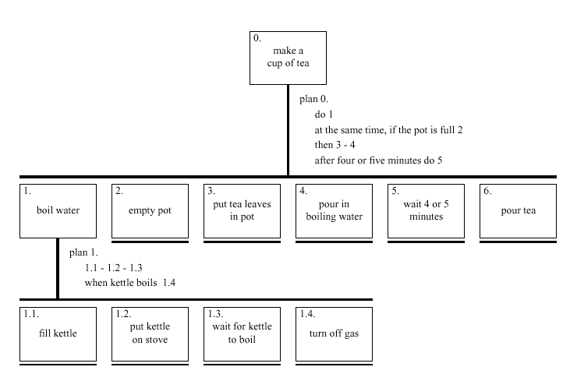
Diagrammatic HTA

Slide 56
Refining the description
Given initial HTA (textual or diagram)
  How to check / improve it?
Some heuristics:
  paired actions e.g., where is `turn on gas'
  restructure e.g., generate task `make pot'
  balance e.g., is `pour tea' simpler than making pot?
  generalise e.g., make one cup ….. or more

Slide 57
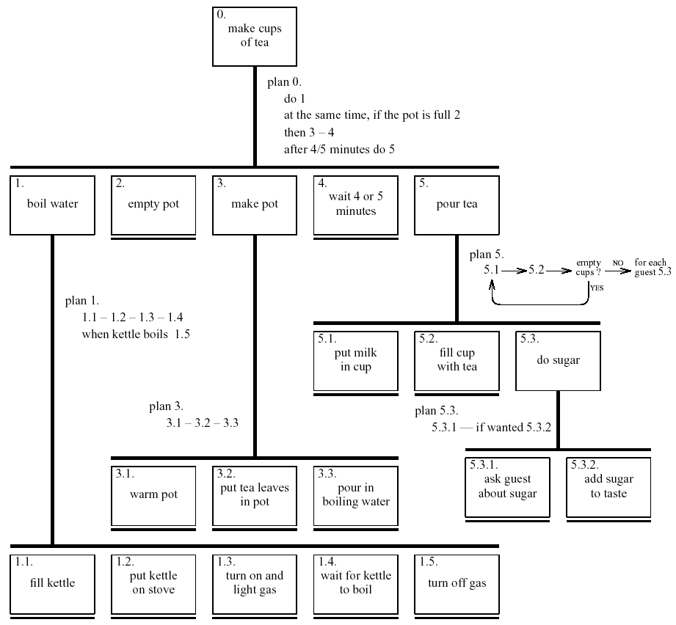
Refined HTA for making tea

Slide 58
Types of plan
fixed sequence - 1.1 then 1.2 then 1.3
optional tasks - if the pot is full 2
wait for events - when kettle boils 1.4
cycles - do 5.1 5.2 while there are still empty cups
time-sharing - do 1; at the same time ...
discretionary - do any of 3.1, 3.2 or 3.3 in any order
mixtures - most plans involve several of the above

Slide 59
Name the plan type
QUIZ
4 min · alone · mobile-wallet top-up
1
Open the app, choose Mobile Load, enter the number — in that order
2
If the number is saved, pick it from contacts
3
When the OTP arrives, enter it
4
Repeat for each family member’s phone
5
While the payment processes, check the balance by SMS
6
Enter the amount and choose the network, in either order
fixed sequence · optional · wait for events · cycles · time-sharing · discretionary · mixtures
Notes:
QUIZ, 4 minutes. Use the seven plan types from the previous slide.

Slide 60
Name the plan type — answers
ANSWERS
mobile-wallet top-up
1
Open the app, choose Mobile Load, enter the number — in that order
2
If the number is saved, pick it from contacts
Fixed sequence
Optional task
3
When the OTP arrives, enter it
4
Repeat for each family member’s phone
Wait for event
Cycle
5
While the payment processes, check the balance by SMS
6
Enter the amount and choose the network, in either order
Time-sharing
Discretionary
Put together, the whole top-up plan is a mixture — most plans are.
Notes:
ANSWERS. The same task appears in Figma Lab 6 (HTA of a mobile-wallet recharge in FigJam).

Slide 61
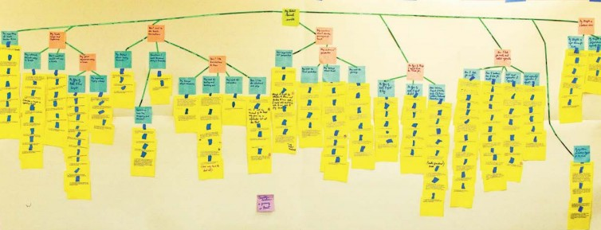

Slide 62
Worked Exercise
Produce a high-level hierarchical task analysis showing how you would find information on a website. Assume the site has a search facility as well as normal links.

Slide 63
Worked exercise — a model answer
ANSWERS
after 8 minutes in pairs, on paper
0
find information on a website
1
decide how to look
2
search
3
follow links
4
read the page
5
note the information
2.1
type keywords
2.2
submit
2.3
scan results
3.1
scan the page
3.2
choose a link
3.3
follow it
Plan 0: do 1; if searching do 2, else do 3; then 4; if found do 5, if not go back to 1
Plan 2: 2.1 – 2.2 – 2.3 Plan 3: 3.1 – 3.2 – 3.3, repeat until a likely page
Many correct answers exist. Check yours has: sensible levels · a choice (search or browse) · a cycle back.
Notes:
Give pairs 8 minutes on the Worked Exercise slide before showing this.
Marking guide if used for credit (5): sensible hierarchy (2), plan 0 with the search-or-browse choice (2), a cycle back when the information is not found (1).

Slide 64
Knowledge Based Analyses
Focus on:
Objects – used in task
Actions – performed
+ Taxonomies –
represent levels of abstraction

Slide 65
Knowledge–Based Example …
motor controls
steering steering wheel, indicators
engine/speed
gearing clutch, gear stick
lights
external headlights, hazard lights
internal courtesy light
wash/wipe
wipers front wipers, rear wipers
washers front washers, rear washers
heating temperature control, air direction,
fan, rear screen heater
parking hand brake, door lock
radio numerous!

Slide 66
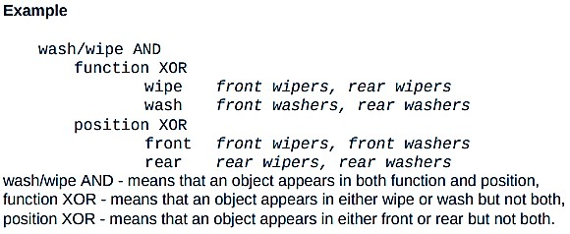
Task Description Hierarchy
:A special form of taxonomy of KBA
Three types of branch point in taxonomy:
XOR – normal taxonomy
object in one and only one branch
AND – object must be in both
multiple classifications
OR – weakest case
can be in one, many or none

Slide 67
Larger TDH example
kitchen item AND
/____shape XOR
/ |____dished mixing bowl, casserole, saucepan,
/ | soup bowl, glass
/ |____flat plate, chopping board, frying pan
/____function OR
{____preparation mixing bowl, plate, chopping board
{____cooking frying pan, casserole, saucepan
{____dining XOR
|____for food plate, soup bowl, casserole
|____for drink glass
‘/|{’ used for branch types, AND, XOR, Or respectively.

Slide 68
More on TDH
Uniqueness rule:
  can the diagram distinguish all objects?
e.g., plate is:
kitchen item/shape(flat)/function{preparation,dining(for food)}/
nothing else fits this description
Actions have taxonomy too:
  kitchen job OR
  |____ preparation beating, mixing
  |____ cooking frying, boiling, baking
  |____ dining pouring, eating, drinking

Slide 69
XOR, AND or OR?
QUIZ
3 min · alone · LMS classifications
1
Each course item is exactly one of: lecture, quiz or assignment
2
Every course item is classified by both its type and its week
3
A resource can carry any of the tags exam-prep, lab, optional — or none
4
Each portal user is a student, a teacher or an admin
XOR | AND / OR {
Notes:
QUIZ, 3 minutes.

Slide 70
XOR, AND or OR? — answers
ANSWERS
branch types in a TDH
1
Each course item is exactly one of: lecture, quiz or assignment
2
Every course item is classified by both its type and its week
XOR — one and only one branch
AND — multiple classifications
3
A resource can carry any of the tags exam-prep, lab, optional — or none
4
Each portal user is a student, a teacher or an admin
OR — one, many or none
XOR … unless someone is both: then OR
Item 4: a PhD scholar who also teaches is both — real data breaks neat taxonomies. Check the uniqueness rule against real users.
Notes:
ANSWERS. Item 4 is the discussion point.

Slide 71
Entity-Relationship Techniques
Focus on objects, actions and their relationships
Similar to OO analysis, but …
  includes non-computer entities
  emphasises domain understanding not implementation
Running example
  ‘Vera's Veggies’ – a market gardening firm
  owner/manager: Vera Bradshaw
  employees: Sam Gummage and Tony Peagreen
  various tools including a tractor `Fergie‘
  two fields and a glasshouse
  new computer controlled irrigation system

Slide 72
Objects
Start with list of objects and classify them:
Concrete objects:
  simple things: spade, plough, glasshouse
Actors:
  human actors: Vera, Sam, Tony, the customers
  what about the irrigation controller?
Composite objects:
  sets: the team = Vera, Sam, Tony
  tuples: tractor may be < Fergie, plough >

Slide 73
Attributes
To the objects add attributes:
  Object Pump3 simple – irrigation pump
  Attributes:
  status: on/off/faulty
  capacity: 100 litres/minute
N.B. need not be computationally complete

Slide 74
Actions
List actions and associate with each:
agent – who performs the actions
patient – which is changed by the action
instrument – used to perform action
examples:
Sam (agent) planted (action) the leeks (patient)
Tony dug the field with the spade (instrument)

Slide 75
Actions (ctd)
implicit agents – read behind the words
  `the field was ploughed' – by whom?
indirect agency – the real agent?
  `Vera programmed the controller to irrigate the field'
messages – a special sort of action
  `Vera told Sam to ... '
rôles – an agent acts in several rôles
  Vera as worker or as manager

Slide 76
example – objects and actions
Object Sam human actor
Actions:
S1: drive tractor
S2: dig the carrots
Object Vera human actor
– the proprietor
Actions: as worker
V1: plant marrow seed
V2: program irrigation controller
Actions: as manager
V3: tell Sam to dig the carrots
Object the men composite
Comprises: Sam, Tony
Object glasshouse simple
Attribute:
humidity: 0-100%
Object Irrigation Controller
non-human actor
Actions:
IC1: turn on Pump1
IC2: turn on Pump2
IC3: turn on Pump3
Object Marrow simple
Actions:
M1: germinate
M2: grow

Slide 77
Events
… when something happens
performance of action
‘Sam dug the carrots’
spontaneous events
‘the marrow seed germinated’
‘the humidity drops below 25%’
timed events
‘at midnight the controller turns on’

Slide 78
Relationships
object-object
  social - Sam is subordinate to Vera
  spatial - pump 3 is in the glasshouse
action-object
  agent (listed with object)
  patient and instrument
actions and events
  temporal and causal
  ‘Sam digs the carrots because Vera told him’
temporal relations
  use HTA or dialogue notations.
  show task sequence (normal HTA)
  show object lifecycle

Slide 79
example – events and relations
Events:
Ev1: humidity drops below 25%
Ev2: midnight
Relations: object-object
location ( Pump3, glasshouse )
location ( Pump1, Parker’s Patch )
Relations: action-object
patient ( V3, Sam )
– Vera tells Sam to dig
patient ( S2, the carrots )
– Sam digs the carrots ...
instrument ( S2, spade )
– ... with the spade
Relations: action-event
before ( V1, M1)
– the marrow must be sown
before it can germinate
triggers ( Ev1, IC3 )
– when humidity drops
below 25%, the controller
turns on pump 3
causes ( V2, IC1 )
– the controller turns on the
pump because Vera
programmed it

Slide 80
Agent, patient, instrument — or hidden?
CASE PUZZLE
5 min · pairs
1
“Ayesha paid the LESCO bill with JazzCash.”
2
“The fee challan was verified.”
3
“Sir Imran set the LMS to close submissions at midnight.”
4
“The warden told Bilal to fix the fan.”
For each sentence: agent? action? patient? instrument? Anything special — implicit agent, indirect agency, message, rôle, event?
Notes:
CASE PUZZLE, 5 minutes in pairs, after the Vera’s Veggies examples.

Slide 81
Agent, patient, instrument — or hidden? — answers
ANSWERS
actions, rôles and events
1
“Ayesha paid the LESCO bill with JazzCash.”
2
“The fee challan was verified.”
agent Ayesha · action pay · patient the bill · instrument JazzCash
implicit agent — by whom? A bank officer, or the system? Ask.
3
“Sir Imran set the LMS to close submissions at midnight.”
4
“The warden told Bilal to fix the fan.”
indirect agency — Sir Imran is the real agent; midnight is a timed event
a message; warden acting in a manager rôle; Bilal agent of “fix”, the fan its patient
Item 2 is the design lesson: documents full of passive sentences hide who actually does the work. Ask “by whom?”.
Notes:
ANSWERS. Connect item 3 to the Vera slide: “Vera programmed the controller to irrigate the field”.

Slide 82
Sources of Information
Documentation
  N.B. manuals say what is supposed to happen
  but, good for key words and prompting interviews
Observation
  formal/informal, laboratory/field (see Chapter 9)
Interviews
  the expert: manager or worker? (ask both!)

Slide 83
Early analysis
Extraction from transcripts
  list nouns (objects) and verbs (actions)
  beware technical language and context:
  `the rain poured’ vs. `I poured the tea’
Sorting and classifying
  grouping or arranging words on cards
  ranking objects/actions for task relevance (see ch. 9)
  use commercial outliner
Iterative process:
  data sources  analysis
  but costly, so use cheap sources where available

Slide 84
Uses – manuals & documentation
Conceptual Manual
  from knowledge or entity–relations based analysis
  good for open ended tasks
Procedural ‘How to do it’ Manual
  from HTA description
  good for novices
  assumes all tasks known
To make cups of tea
Make pot of tea
once water has boiled
boil water –– see page 2
empty pot
make pot –– see page 3
wait 4 or 5 minutes
pour tea –– see page 4
warm pot
put tea leaves in pot
pour in boiling water
–– page 1 ––
–– page 3 ––

Slide 85
Uses – requirements & design
Requirements capture and systems design
  lifts focus from system to use
  suggests candidates for automation
  uncovers user's conceptual model
Detailed interface design
  taxonomies suggest menu layout
  object/action lists suggest interface objects
  task frequency guides default choices
  existing task sequences guide dialogue design
NOTE. task analysis is never complete
  rigid task based design ⇒ inflexible system

Slide 86
Exit ticket
LIVE EXERCISE
5 min · alone, on paper · hand in at the door
Name two user-profile questions you would ask about your Lab 5 project users, and one design consequence of each.
1
Draw a two-level HTA for “pay hostel dues online”, with plan 0.
2
What is still unclear after today?
3
Lab 5 — Know Your Users (Figma): bring your pre-lab interview notes. Task analysis feeds Lab 6.
Notes:
EXIT TICKET, 5 minutes. Collect at the door; use the answers to question 3 to open next week.

Slide 87
End of the Lecture

